Slide 1



THE “ACTIVE SHOOTER”
PREVENTION, RESPONSE, AND LIABILITY
Richard S. Linkert, Esq.
Matheny Sears Linkert & Jaime LLP
3638 American River Drive
Sacramento, California 95864
www.mathenysears.com

Slide 2

INSURANCE AND UNDERWRITING PERSPECTIVES
Kyle Rolf, CPCU, AU-M
Underwriter, Deadly Weapons Protection
BEAZLEY GROUP
725 S. Figueroa Street Suite 20520
Los Angeles CA 90017
kyle.rolf@beazely.com
619-395-5356

Slide 3


OUR WORLD
  RISING FREQUENCY OF INCIDENTS
  INCREASING LEVELS OF VIOLENCE
  MEDIA ATTTENTION
  HINDSIGHT LIABILITY COMBINED WITH PREDICTION IMPOSSIBILTY

Slide 4
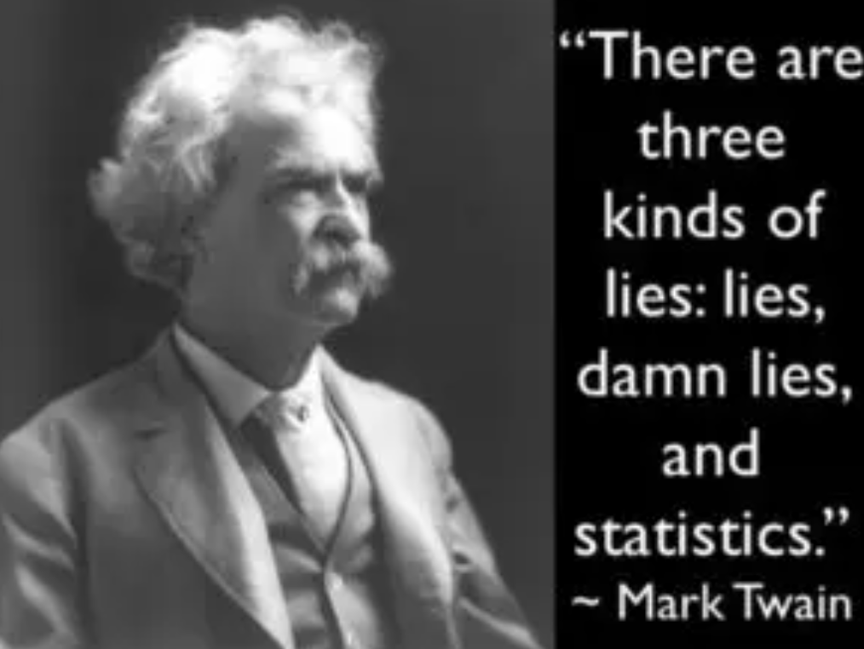

Slide 5

WHAT IS A MASS SHOOTING?
FBI Definition
  Actively engaged in killing or attempting to kill people in a populated area
  3 or more fatalities
Gun Violence Archive / Media
  4 or more shot and / or killed
Who commits these acts?
  Customers, clients, patients, and other 3rd parties
  Employees or supervisors
  Domestic partners or relatives of employees
  Typically, males between the age of 18 and 25 who are often victims of bullying
Notes:
Who commits these acts? There is an unpredictability factor when it comes to these violent acts, meaning any one of us could experience work place violence without any rhyme or reason

Slide 6
THE FIGURES
Location of US Active Shooter Events
2000 - 2019
8 in 10
of all murders and suicides
in the U.S. involved a gun
in 2020
PEW research centre
116
average of Americans who die
from gun violence daily
Giffords
Commerce

Slide 7
ANNUAL STATISTICS
Mass shooting statistics¹
2019​ | 2020​ | 2021​ | 2022
415​ total incidents 35 ​ mass shootings per month​ | 610 ​ total incidents ​ 51​ mass shootings per month​​ | 690 ​ total incidents 58​ mass shootings per month​ | 646 ​ total incidents 53 mass shootings per month​
Gun violence statistics¹​
2020​ | 2021​ | 2022
total of ​ 43,736 ​ deaths, equating to ​ 119 ​ deaths each day​ | total of ​ 45,126​ deaths, equating to ​ 123 ​ deaths each day​ | total of ​ 44,352​ deaths, equating to ​ 121 ​ deaths each day​
Stats sourced from gunviolencearchive.org

Slide 8
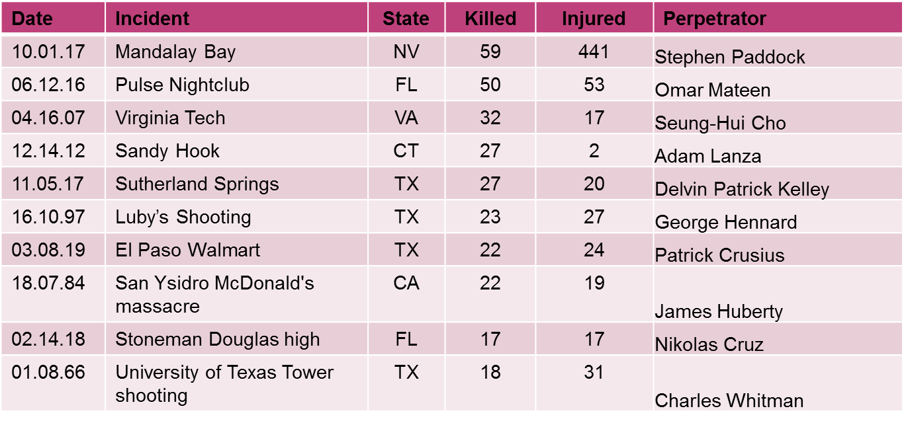
TOP 10 COSTLIEST US ACTIVE SHOOTER EVENTS BY CASUALTY LOSSES

Slide 9

ONGOING SOURCES OF TENSION
COVID-19
Social justice movements
Mental health
National and local political issues
Domestic terrorism
The economy

Slide 10
EXEMPLAR AFFECTED INSTITUTIONS
Any Business and Third-Party Claims
BUSINESS
Public
Private
SCHOOLS
Elementary
Middle High
College
HOTEL AND EVENTS

Slide 11

PROTECTION GOALS
    EMPLOYEES
    CUSTOMERS
    STUDENTS
    THE BUSINESS OR INTITUTION

Slide 12
WHAT IS AN “ACTIVE SHOOTER”?
“An individual(s) actively engaged in killing or attempting to kill people in a populated area.”
(source: White House, U.S. Dept. of Justice/FBI, U.S. Dept. of Education, and Dept. of Homeland Security/FEMA)
Generally, uses firearms, but can also use explosives and cutting instruments

Slide 13
OTHER THREAT DEVICES
CHEMICALS AND ACIDS
KNIVES AND SHARPS
ARSON AND INCENDIARY DEVICES
BOMBS AND EXPLOSIVES
POISONS AND CONTAMINATIONS
MOTOR VEHICLES
DRONES

Slide 14

THE HINDSIGHT STANDARD:
EMPLOYEE AND PUBLIC EXPECTATIONS
    EXPECTATION OF SAFETY
    INABILITY TO PREDICT VIOLENT BEHAVIOR
    “IF IT HAPPENED BEFORE, IT CAN BE PREVENTED”
    HINDSIGHT STANDARD IN THE MINDS OF VICTIMS AND JURORS
    THESE COMBINE TO SIGNIFICANTLY INCREASE LIABILITY

Slide 15
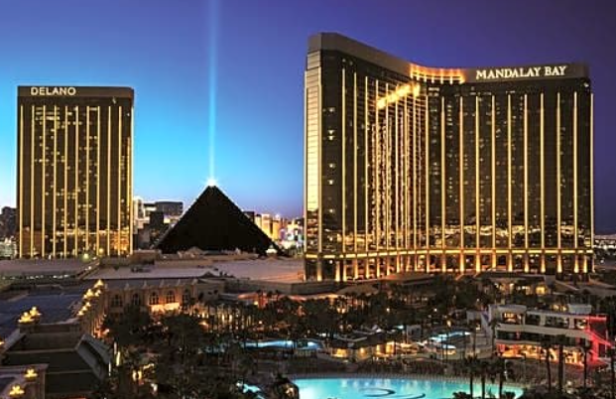
THE MANDALAY BAY ASSAULT
    LAS VEGAS SHOOTING 2017
      Shooting at an outdoor concert from elevated hotel room
      58 dead, 800 injured in shooting and aftermath
      Plaintiffs claimed the hotel was negligent in allowing the shooter to stockpile weapons
      Hotel settled most cases for a collective sum of $800 Million

Slide 16
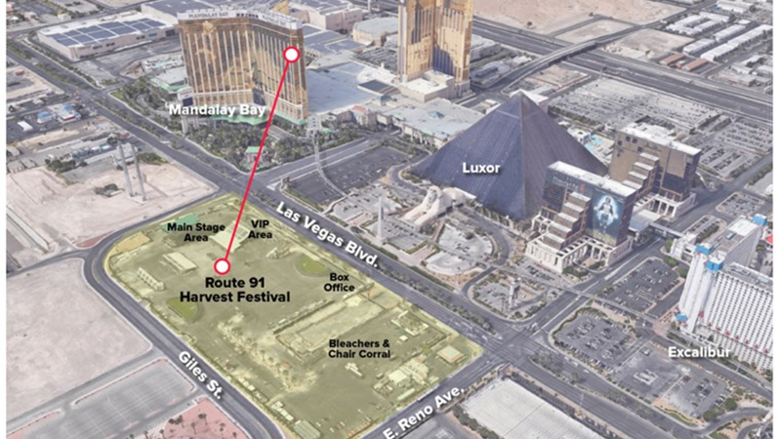

Slide 17
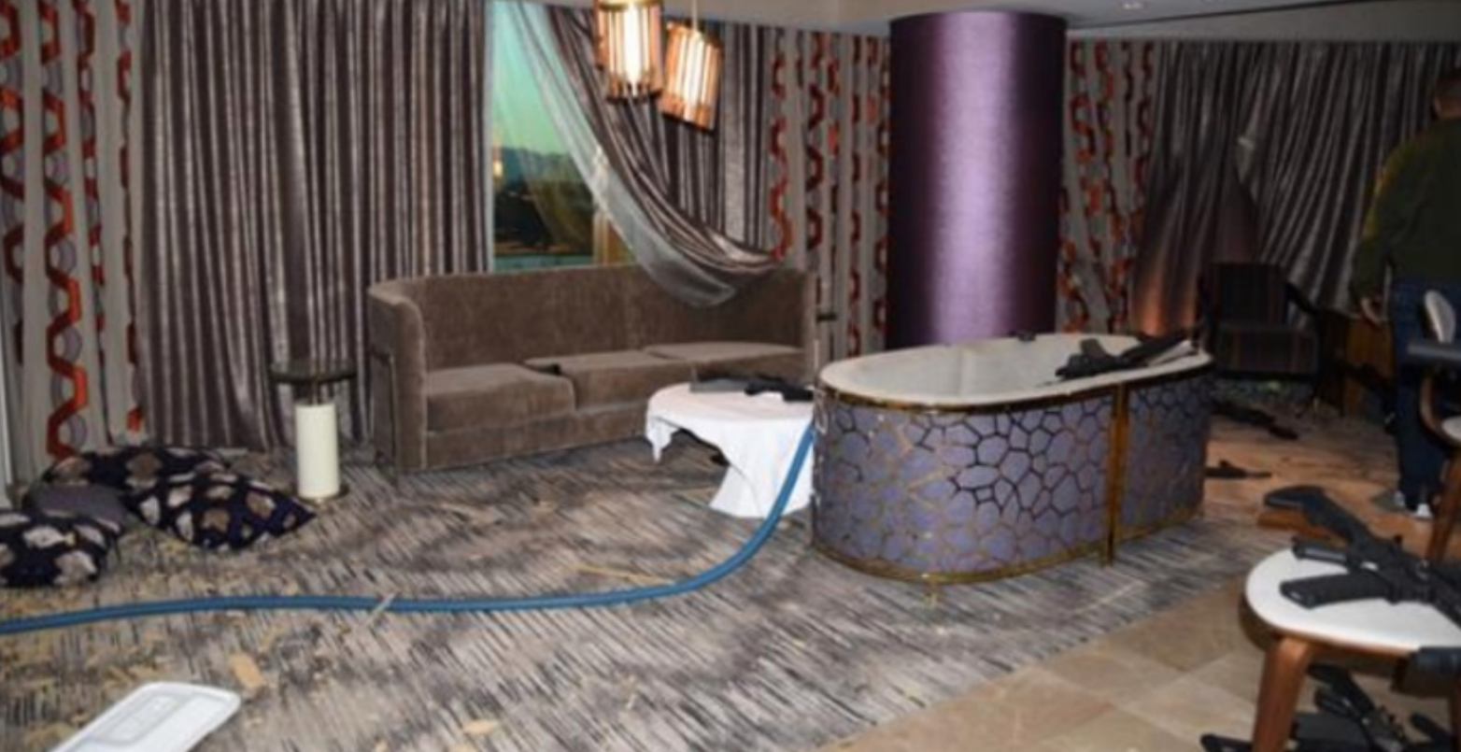

Slide 18
THE MANDALAY BAY IMPACT:
HOTELS AND OTHER BUSINESS
EXPECTATION OF HEIGHTENED SECURITY
INSPECTIONS OF LUGGAGE, BRIEFCASES, COATS, HOODIES, AND BACKPACKS – NOW GOLF AND SKI BAGS
METAL DETECTORS
ARMED GUARDS

Slide 19
PREVENTATIVE MEASURES
DETECTION
Warning signs
Employees/spouses and partners
Third Parties
THREAT ASSESSMENT
“Threat Assessment Teams” (TAT) increasing

Slide 20

PREVENTATIVE MEASURES
HUMAN RESOURCE Department
Should engage in planning for emergency situations, including an active shooter scenario, by:
Conducting effective employee screening and background checks
Creating a system for reporting signs of potentially violent behavior
Making counseling services available to employees
Developing an Emergency Action Plan that includes policies and procedures for dealing with an active shooter situation, as well as after-action planning
(source: FEMA IS-907Active Shooter: What You Can Do)

Slide 21
PREVENTATIVE MEASURES
There are no “usual suspects.”
There is no demographic profile of a targeted violence offender.
Objective assessment of threat enhancing and mitigating circumstances is the key to evaluating concern for violence.
Any individual, no matter what age, sex, race, religion, education or income level, marital status, or occupation, has the potential to engage in targeted violence.

Slide 22
PREVENTATIVE MEASURES
The first step in preventing future violence is identifying and evaluating a person’s behaviors.
No single behavior is predictive of targeted violence; rather, a “perfect storm” sometimes develops based on a multitude of factors and conditions.
When conducting an assessment, the facts and circumstances identified in this chapter must each be examined while focusing on the person of concern, the potential target(s), the situation, and the setting.

Slide 23
PREVENTATIVE MEASURES
Threat assessment is a multifaceted process, stemming from a holistic analysis of the pattern of behaviors displayed by a person of concern.
(source: FBI Behavior Analysis Unit (BAU) Making Prevention a Reality)

Slide 24

SEE (HEAR OR READ) SOMETHING, SAY SOMETHING
  Transforming bystanders into upstanders is a must
  However, bystanders may feel overwhelmed by or fearful of informing on a friend or associate
  Potential for ridicule
  Potential reprisal from person of concern or organization

Slide 25

SEE (HEAR OR READ) SOMETHING, SAY SOMETHING
    Fear of being a “snitch”
    Potential of not being taken seriously
    Uncertainty about the seriousness of the info or situation
      Mistrust of confidentiality or of the system to handle situation appropriately
      Desire to remain uninvolved in the affairs of others
      Other concerns which may be unique to each person

Slide 26
SEE (HEAR OR READ) SOMETHING, SAY SOMETHING
    To overcome multiple reporting obstacles, there will likely need to be a cultural shift
    Education
    Common goals of protecting everyone
    An expression of corporate policy – if the policy is to default in favor of health and safety of fellow employees and customers, it is easier to report concerns for evaluation

Slide 27
PREVENTION RESOURCE
The FBI’s behavioral experts in the Behavioral Threat Assessment Center (BTAC) are available to work with TATs and develop threat mitigation strategies for persons of concern.
BTAC members rely upon extensive research and operational experience to assist in identifying, assessing, and managing persons of concern who may become violent.

Slide 28
PREVENTION RESOURCE
BTAC services can be accessed by contacting the Behavioral Analysis Unit [BAU] Coordinator in any of the FBI’s 56 field offices located throughout the United States.

Slide 29
PREVENTION:
WARNING SIGNS
Employees typically do not just “snap,” but display indicators of potentially violent behavior over time.
If these behaviors are recognized, they can often be managed and treated.

Slide 30
PREVENTION:
WARNING SIGNS
Potentially violent behaviors by an employee may include one or more of the following:
Increased use of alcohol and/or illegal drugs
Unexplained increase in absenteeism; vague physical complaints
Noticeable decrease in attention to appearance and hygiene
Depression / withdrawal / mood swings / paranoia
Resistance and overreaction to changes in policy and procedures

Slide 31
PREVENTION:
WARNING SIGNS
Repeated violations of company policies
Noticeably unstable, emotional responses
Explosive outbursts of anger or rage without provocation
Suicidal; comments about ‘putting things in order’
Behavior which is suspect of paranoia (‘everybody is against me’)
Increasingly talks of problems at home

Slide 32
PREVENTION:
WARNING SIGNS
Talk of previous incidents of violence
Empathy with individuals committing violence
Increase in unsolicited comments about firearms, other dangerous weapons, and violent crimes
The angry/mentally ill partner, spouse threat

Slide 33
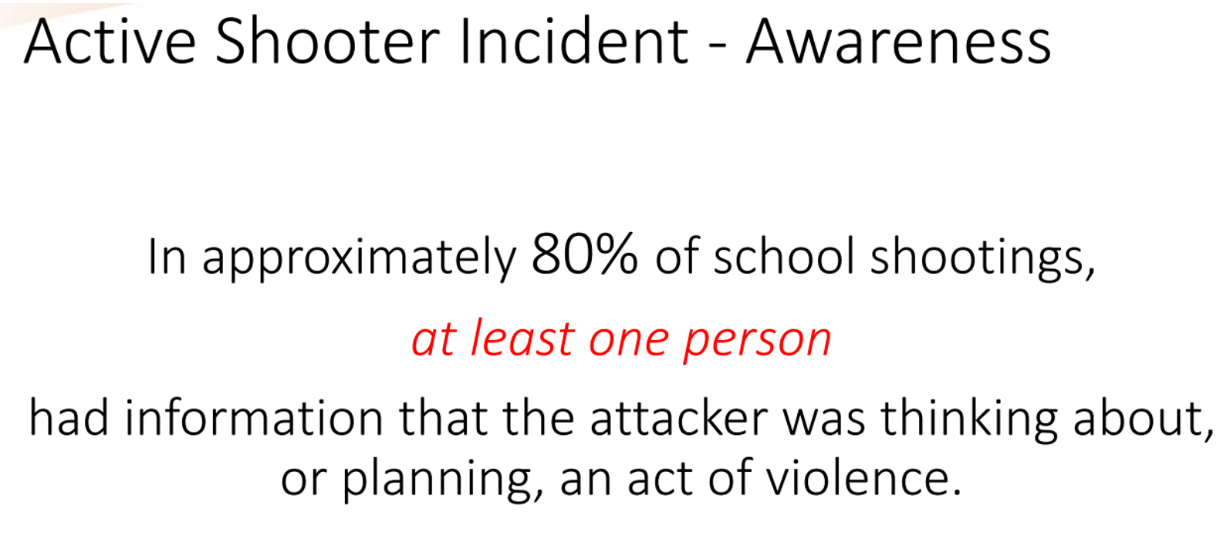

PREVENTION: WARNING SIGNS
Someone Knows Something

Slide 34
RESPONDING TO ACTIVE SHOOTER
FBI, DHS/FEMA all provide similar advice:
RUN
HIDE
FIGHT

Slide 35
REGULATORY LANDSCAPE
OSHA requirements
  General Duty Clause Section 5(a)(1) - an employer is required to furnish a place of employment which is free from recognized hazards that are causing and likely to cause death or serious physical injury to its employees
  Active shooter is now a recognized hazard
Employer liability
Liability is on the employer to train their employees to recognize the indicators of a potential active shooter and how to respond when they are faced with an actual active shooter situation
Civil lawsuits – negligence
Training to recognize potential shooters and respond
Training needs to be made available and safeguards put in place
Location of insured’s business becoming more frequently targeted for claims of negligent security and employee / 3rd party welfare

Slide 36
TRADITIONAL INSURANCE OPTIONS
General Liability | Terrorism
May not respond unless the insured is deemed liable Ambiguity regarding personal attacks against customers or other third parties Excludes employees Excludes damage to property of subsequent business interruption High SIR Occurrence = Accident | Terrorism defined as political, religious or ideological act Physical damage trigger required Third part cover purchased as separate add-on No crisis management
Workers Compensation | TRIPRA
Varies by state Excludes property damage Excludes injuries to any third party | $5m triggers threshold for property and casualty combined “Certified” acts of terrorism only
Workplace Violence | Property All Risk
Excludes injuries to any third party | Requires physical damage trigger If sublimit are offered for various services they are often extremely restrictive
Little to no prevention or crisis management services

Slide 37
INSURANCE CONSIDERATIONS
Trend in jury verdicts is up dramatically around the State
1
Driven by multiple factors
Public anger and desire for a voice
Increased cost of long-term health care
Work with brokers to obtain maximum excess insurance
2
Consider special event insurance for large gatherings
3
Obtain “contractual indemnity” and “Named Additional Insured” status whenever possible
4

Slide 38
LEGAL ISSUES
THEORIES OF LIABILITY AGAINST PROPERTY OWNER AND/OR BUSINESS (BANK)
Premises Liability / Dangerous Condition
For shooting itself
For not having proper exits
For not having proper EAP in place

Slide 39
LEGAL ISSUES
THEORIES OF LIABILITY AGAINST PROPERTY OWNER AND/OR BUSINESS (BANK)
NOTICE
Actual Notice
Report of a threat
Signs of a threat
The “Did Know” standard

Slide 40
THE PROBLEM WITH NEGLIGENCE
In a perfect world, jurors would dispassionately follow the law.
However, many factors influence deliberations, including:
Sympathy for victims and the “reverse-engineering” of verdicts
Concern for community safety
“Sending a Message” to corporate America
20/20 Hindsight- the puzzle is easy to see once assembled
The emerging notion that all harm should be compensable, with or without fault – particularly where large institutions are involved
Disturbing trends to place more blame on an [innocent] business than the criminal

Slide 41
DEFENSE ATTORNEY OBSERVATIONS
The development and implementation of “Active Shooter” policies and procedures:
Prevention/Detection
Response
Serves (at least) three goals:
Safer workplace for employees
Safer business environment for customers
Provide a defense to a liability claim

Slide 42
THE WORLD OF 20/20 HINDSIGHT
We live in a world where 20/20 hindsight is the effective standard.
The perception is that gun violence is increasing and, therefore, foreseeable.
The absence of forethought, a plan, and training will likely result in liability
There are various resources that can and should be used

Slide 43
THE ISSUE OF “NUCLEAR VERDICTS
Recent Examples
  Sexual Molestation – San Jose - 2 High School Students - $105, 000,000
  Sexual Molestation – Marin -Coach Brushed Genitals - $10,000,000
  Wrongful death –Butte County - seasonal laborer – $10,000,000
  Brain Injury – Orange County – Hotel - $60,000,000
  Sexual Assault – Locker room by teammates – Sacramento - $2,700,000; $100,000 pre-trial settlement for second Plaintiff.

Slide 44
ESSENTIAL INGREDIENTS
IGNORING CORE FACTS: IS IT A BAD CASE?
FAILRE TO ACCEPT RESPONSIBILITY
UNREASONABLENESS
FAILURE TO ANCHOR - GIVE A NUMBER – BEGINNING IN VOIR DIRE
FAILURE TO DEVELOP A “COMON SENSE” THEME

Slide 45
WHILE THE DEFENSE SLEPT…
PLAINTIFFS COMPLETELY CHANGED STRATEGY
OLD – Never ask for huge numbers
NEW – Ask for huge numbers
OLD – Sympathy
NEW – Anger
OLD – Hints at “Golden Rule”
NEW- Full-on Reptile Theory – incite jury to protect the community

Slide 46
THE DEFENSE IS WAKING UP
Credit – Bob Tyson of Tyson Mendes – “NUCLEAR VERDICTS”
  www.tysonmendes.com
While the Defense Industry focused on metrics and audits – the game changed dramatically
POST-COVID expectations were shattered
  Surely juries would be more conservative after the long dark lockdown
Juries now more than ever - appear to be exercising power and respond when angry at the defense

Slide 47
JUROR ANGER AND POWER
“Nuclear Verdicts” are usually the result of a confluence of factors
01
Combine to result in ANGER - Triggering the exercise of POWER
The Importance of the Key Event(s)
02
The Importance of Defendant Culpability
03
Is “Foreseeability” Dead? “Well, It Happened, Didn’t It”
04
Is There an Outer Boundary of “Responsibility?”
05

Slide 48

QUESTIONS/COMMENTS
3638 American River Dr. Sacramento, CA 95864-5901 916-978-3434
www.mathenysears.com

Slide 49
APPENDIX

Slide 50
TRAINING FOR ACTIVE SHOOTER
Create an Emergency Action Plan (EAP) and conduct training exercises. Together, the EAP and training exercises will prepare your staff to effectively respond and help minimize loss of life.
Components of an EAP: Create the EAP with input from several stakeholders including your HR department, your training department, facility owners/operators, property manager, and local/federal law enforcement.

Slide 51
TRAINING FOR ACTIVE SHOOTER
An effective EAP includes:
A clear procedure for reporting
An evacuation policy and procedure involving at least two escape routes
Emergency escape response procedures and route assignments (i.e., floor plans, safe areas)
Contact information for, and responsibilities of, individuals to be contacted under the EAP

Slide 52
TRAINING FOR ACTIVE SHOOTER
Information concerning local area hospitals (i.e., name, telephone number, and distance from location)
An emergency notification system to alert various parties of an emergency including:
Individuals at remote locations within premises
Local law enforcement
Local area hospitals
(source: FEMA IS-907 Active Shooter: What You Can Do)

Slide 53
TRAINING EXERCISES
The most effective way to train your staff to respond to an active shooter is to conduct mock active shooter training exercises.
Local law enforcement is an excellent resource in designing training exercises.

Slide 54
TRAINING EXERCISES
Recognizing the sound of gunshots
Reacting quickly when gunshots are heard and/or when a shooting is witnessed:
Run
Hide
Fight the shooter as a last resort
Call 911

Slide 55
TRAINING EXERCISES
Reacting when law enforcement arrives
Adopting the survival mindset during times of crisis
Ensure that EAPs, evacuation instructions, etc. address relevant information for special needs and/or disabled
Compliance with ADA requirements

Slide 56
FACILITY MANAGERS’ RESPONSIBILITIES
Institute access controls (keys, security system pass codes)
Distribute critical items to appropriate managers/employees including:
  Floor plans
  Keys and other access controls
  Facility personnel lists, telephone, and email
  Schedules

Slide 57
FACILITY MANAGERS’ RESPONSIBILITIES
Assemble crisis kits containing:
Radios
Floor plans
Keys, access codes
Employee rosters and contact info
First aid kits
Flashlights

Slide 58
FACILITY MANAGERS’ RESPONSIBILITIES
Activate the emergency notification system
  Develop policy directives for different scenarios for clarity
  Activate or not

Slide 59
FACILITY MANAGERS’ RESPONSIBILITIES
Facility Managers should also:
Ensure there are two evacuation routes
Post evacuation routes
Coordinate with facility security
Post evacuation routes in conspicuous places
Place removal floor plans near exits for law enforcement and first medical responders

Slide 60
FACILITY MANAGERS’ RESPONSIBILITIES
Include law enforcement and first responders in training exercises
1
Consider inviting law enforcement, first responder, SWAT, canine and bomb squads to train for active shooter at your facility
2
Foster a respectful workplace
3
Be aware of indications for workplace violence and take actions
4
(source: FEMA IS-907 Active Shooter: What You Can Do)

Slide 61

RESOURCES
FBI Resources
https://www.fbi.gov/file-repository/making-prevention-a-reality.pdf/view
https://www.fbi.gov/about/partnerships/office-of-partner-engagement/active-shooter-resources/responding-to-an-active-shooter-crisis-situation
FEMA Active Shooter: What you can do. https:emilms.fema.gov/IS907/curriculum/1.html
DHS www.dhs.gov/sites/default/files/publications/active-shooter-how-to-respond-508.pdf
ALICE TRAINING (Alert, Lockdown, Inform, Counter, Evacuate) https://www.alicetraining.com

