Slide 1


Aon Private Risk Management
Exceptional strategies for exceptional achievements
Presentation to RIMS

Slide 2
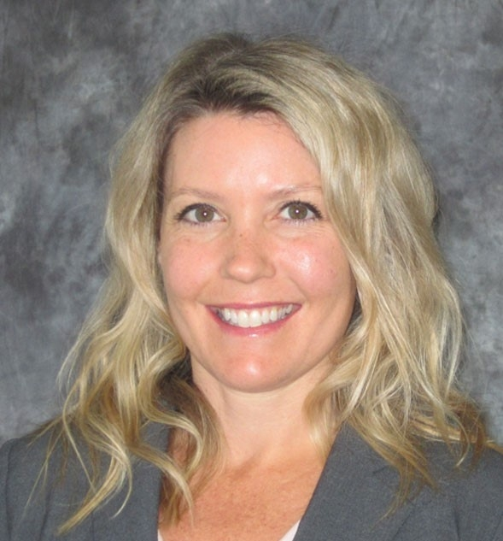
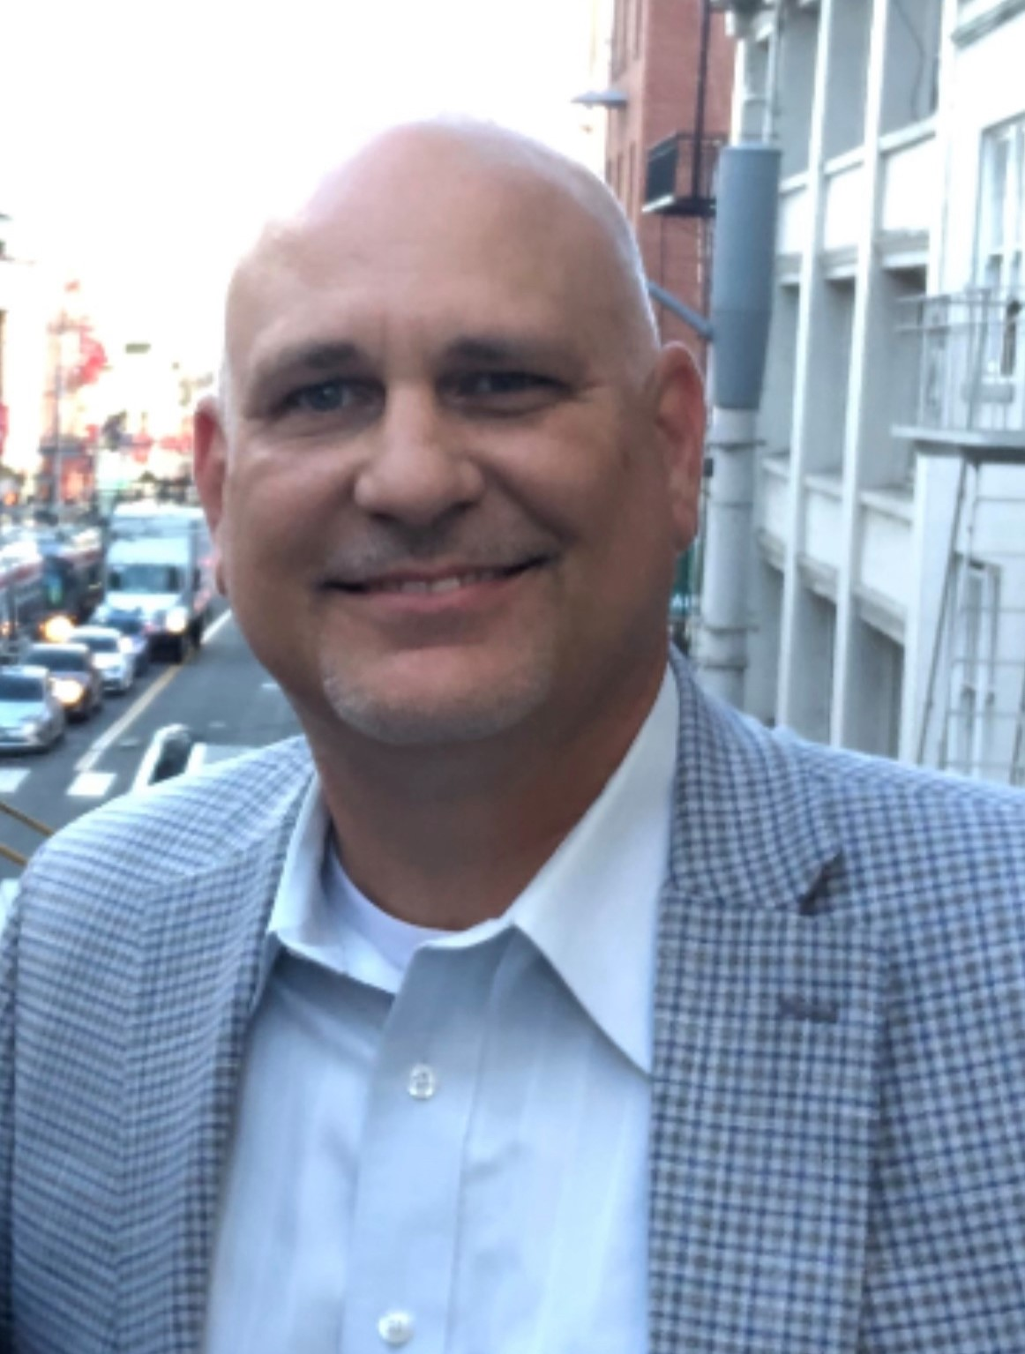
Presenters
Julie Eshelman
Risk Advisor, Aon Private Risk Management
(415) 515-2776
Julie.Eshelman@aon.com
23 years industry experience in various sales & service roles
Works with many family offices & wealthy families
California resident with local knowledge, expertise & connections
Alan Kimberling
Sr. Agency Sales Manager, Northern California
(916) 216-9407
Alan.Kimberling@chubb.com
27 years industry experience with a strong emphasis on high net worth
Drives new business growth
Works with high net worth insurance brokers, family offices and COIs
Strong underwriting background, enjoys crafting tailored solutions for unique risks and affluent clients

Slide 3

Aon Private Risk Management
Aon Private Risk Management (APRM) provides custom risk management and insurance solutions for accomplished individuals and successful families.
A dedicated Account Executive manages each client, evaluating their unique exposures, and designing a personalized plan to minimize the potential for personal and financial loss.
APRM has developed Specialty Service Practices with expertise cultivated to address key risk exposures specific to accomplished individuals – such as family office, fine art & collections, collector cars, superyachts, aviation, equine, etc.
When the worst happens, APRM’s insurance strategies and claims advocacy lead the field in putting it right.
Notes:
Each APRM client has a dedicated Account Executive who offers tailored, highly competitive terms and conditions on behalf of our clients. AE’s are available 24/7 to support each client.
Account Executives leverage (and are often part of) an APRM Specialty Service Practice group, which offer extensive expertise in the 18 areas mentioned on the Specialty Service Practice page. AE’s also pull-in Aon resources as needed to meet risk management requests.
Your Account Executive is the first point of contact in a claims situation. They help coordinate and manage the claims process on behalf of the client. When necessary, Account Executives leverage additional support from, on-staff legal experts in insurance law and contract interpretation, and Aon Global Risk Consulting with their Local claims specialists in Aon offices throughout the world.

Slide 4



Specialty Service Practices
Unique, specialty service practices provide highly-specific expertise, solutions, and risk management for:
Family Office
Fine Art
Collections
Jewelry
Luxury Homes
Collector Cars
Superyacht
Equine
Farm & Ranch
Aviation
Entertainment
Sports
Commercial
Flood
Cyber
Group Excess
Kidnap & Ransom/Travel
Claims

Slide 5
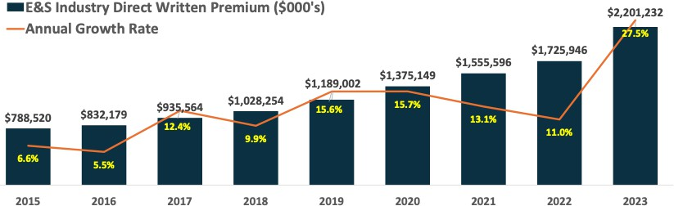
E&S market:
industry home direct written premiums
The admitted insurance market has been pulling back or exiting areas with high potential for catastrophic losses, such as wildfires and hurricanes, driving a significant shift in property premiums to the E&S market.
E&S Industry growth rates
1-year: 27.5%
3 year: 9.1%
5-year: 16.6%
P5
Source: S&P Global E&S Market Share Screener (2015-2023)
Notes:
In the last 10 years, the E&S industry for homeowners written premiums has tripled in size, with the most significant increases coming from 2021 until today. We expect this trend to continue.

Slide 6
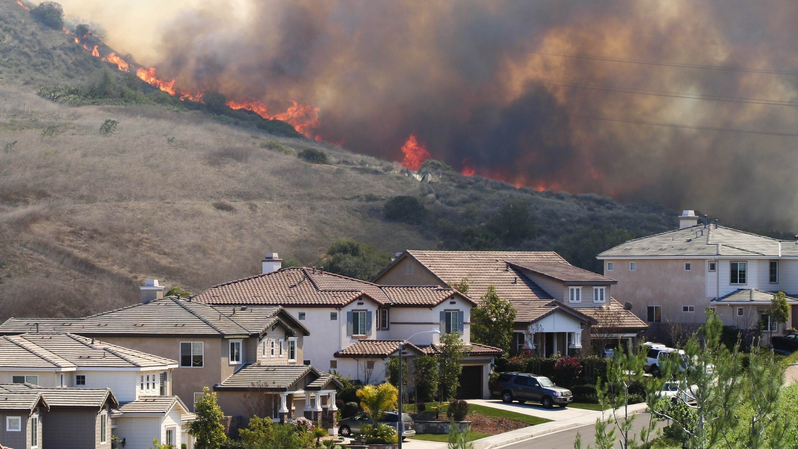
California Fair Plan limitations
  The perils covered with this policy are fire, lightening, internal explosion, and smoke damage.
  Option to include vandalism and/or extended coverages, which covers wind/hail, explosion, riot, aircraft, vehicles and volcanic eruption.
  CA Fair Plan adjusters need to look at the home to see or smell smoke damage, do not assume there is damage as each potential loss is unique.
  The total maximum amount for all coverage is $3m.
  The FAIR Plan is a last resort insurance option
  A Differences in Conditions policy is typically written together with this policy to provide coverage for other perils.
Aon Private Risk Management | Proprietary & Confidential
6
Notes:
In today’s market, with many carriers leaving California or tightening up their guidelines, more people are turning to the CA Fair Plan to obtain coverage. This policy only covers the peril of fire, lightening, internal explosion, and smoke. Their maximum coverage is $3M total insured value. They send their own adjusters to the homes in the event of a loss. We saw that many claims were denied as the adjuster didn’t see or smell smoke but there was ash/soot damage, which is not a covered peril. Clients had to pay a lot of money out of pocket to clean the interior of their home as the Fair Plan called it “dirty” and not damaged by smoke/fire. This left a lot of frustrated homeowners. It’s also important to know that the CA Fair Plan should be treated as a last resort option. If your homeowner carrier non-renewed you, you can obtain quotes from a non-admitted carrier. If the non-admitted carriers decline, then the CA Fair Plan is the only option. We are seeing many more options with non-admitted carriers in the state. However, many people don’t know who to go to to get quotes from non-admitted carriers. These are only accessible by brokers and not the local Allstate, State Farms, or Farmers agents.

Slide 7
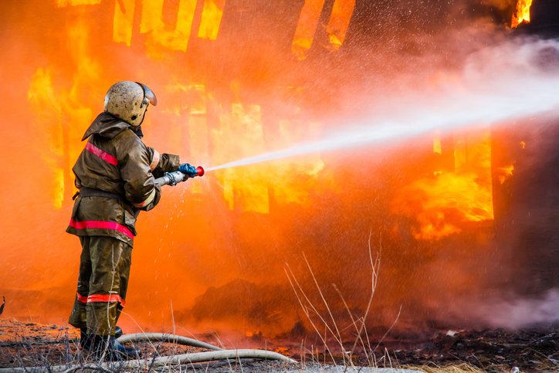
Lessons Learned / Pitfalls of Inadequate Insurance Coverage
Aon Private Risk Management | Proprietary & Confidential
7

Slide 8
Underinsurance
  One of the most common issues reported is underinsurance, where policyholders discover that their coverage limits are insufficient to rebuild or replace their homes and belongings after a total loss.
  Proper reviews of the following are very important:
  Dwelling Limit
  Many homeowners may not have updated their policy limits to reflect current rebuilding costs, which can significantly increase after a disaster.
  Loss of Use Limit
  Personal Property
  Many intentionally underinsured their home to qualify with a specific carrier.
  Valuable Articles
  Ensuring all fine art and jewellery schedules are up to date

Slide 9
Exclusions in Policies
  Many insurance policies contain specific exclusions for certain types of damage or events, such as flood or earthquake.
  Homeowners may find that their policies may have a higher wildfire deductible if they live in designated high-risk areas.
  This lack of understanding can lead to devastating financial losses when a loss occurs.
  There are policies available to cover exclusions and can be purchased separately.
Aon Private Risk Management | Proprietary & Confidential
9

Slide 10

Lack of Adequate Liability Coverage
  Individuals often overlook liability coverage in their homeowner’s insurance policies.
  In the aftermath of wildfires, claims can arise from injuries sustained on properties affected by fires or from smoke damage affecting neighbouring properties.
  Insufficient liability coverage can leave policyholders vulnerable to lawsuits and significant out-of-pocket expenses.
Aon Private Risk Management | Proprietary & Confidential
10

Slide 11
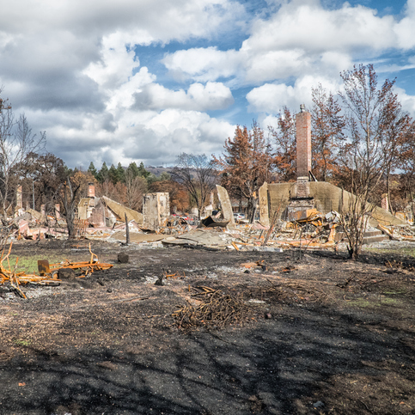
Delayed Claims Processing / Access to Rebuild
  After disasters like wildfires, insurers may face an overwhelming number of claims, leading to delays in processing and payouts.
  Policyholders who do not have adequate temporary living expenses coverage may struggle financially while waiting for claims to be settled.
  Having access to mitigation firms is an important first step to rebuilding.
  Having a broker who can offer assistance or guidance is key in situations like these.
Aon Private Risk Management | Proprietary & Confidential
11

Slide 12





Key Coverages to Consider
  Replacement Cost Coverage
  Extended Replacement Cost Endorsements
  Wildfire-Specific Coverage
  Increased Living Expenses / Loss of Use Coverage
  Comprehensive Liability Coverage

Slide 13
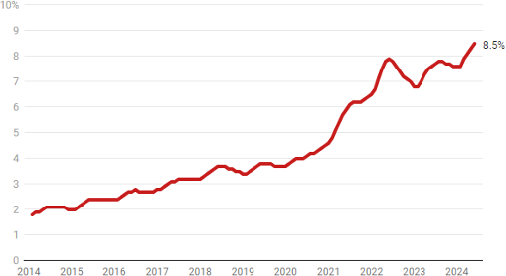
Luxury home values are up 3.9% year-over-year¹
A record 8.5% of U.S. homes are worth $1M-plus
Luxury home inventory remains 46.9% below pre-pandemic levels, a bigger deficit than in the housing market overall¹
Sales grew 0.2%, while sales of non-luxury homes fell 3.4% to the lowest level in a decade²
8.5% of U.S. homes are worth $1M or more, the highest share of all time³
Share of U.S. homes valued at $1M or more ⁴
Source: 1. “Luxury home values are rising faster than typical homes for the first time in years”, Zillow, July 31, 2024,
2. Worley, Mark. “Luxury Home Prices Spike to 9% to All-Time High”, Redfin, July 25, 2024, 3 Anderson, Dana. “Record 8.5% of U.S. Homes are worth $1Million or More”. Redfin, August 16, 2024, 4. Redfin
Notes:
The luxury home market continues to grow, providing you and us the opportunity to sell more High Net Worth Homeowner coverages. Now roughly 9% of all homes in the U.S are valued over $1 M.

Slide 14
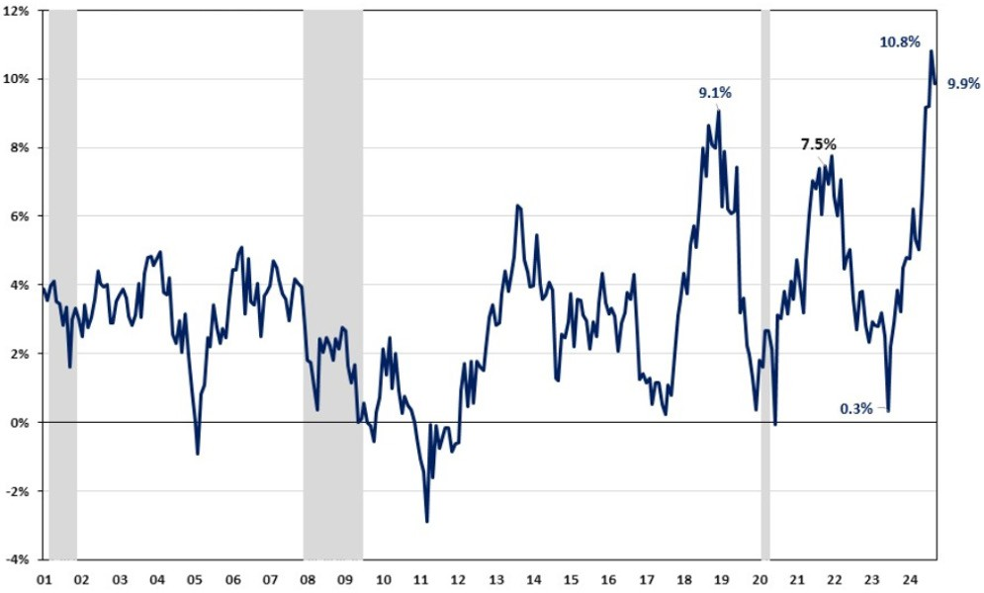
Labor remains the biggest challenge in residential construction
Average hourly wage growth for residential building workers
Wages for residential building workers continued to accelerate in 2024 which continue to inflate building costs
According to the National Association of Home Builders, year-over-year growth rates in the past four months were “unprecedented” in the
near-35-year history of the data series¹
12%
10.8%
10%
9.1%
9.9%
8%
7.5%
6%
4%
Year-over-year percentage growth
2%
0%
0.3%
-2%
-4%
01
02
03
04
05
06
07
08
09
10
11
12
13
14
15
16
17
18
19
20
21
22
23
24
Year
Source: Fu, Jing. “Residential Building Wages Grow at Unprecedented Rate”, National Association of Home Builders November 4, 2024
Notes:
Moving from the value of the home to some of the factors that influence the replacement cost, the average hourly wage for residential building workers continues to increase.
According to the national association of home builders, year over year growth rates over the past four months have been unprecedented.
So that is the bad news…. the better news is that material costs are stabilizing for now.

Slide 15
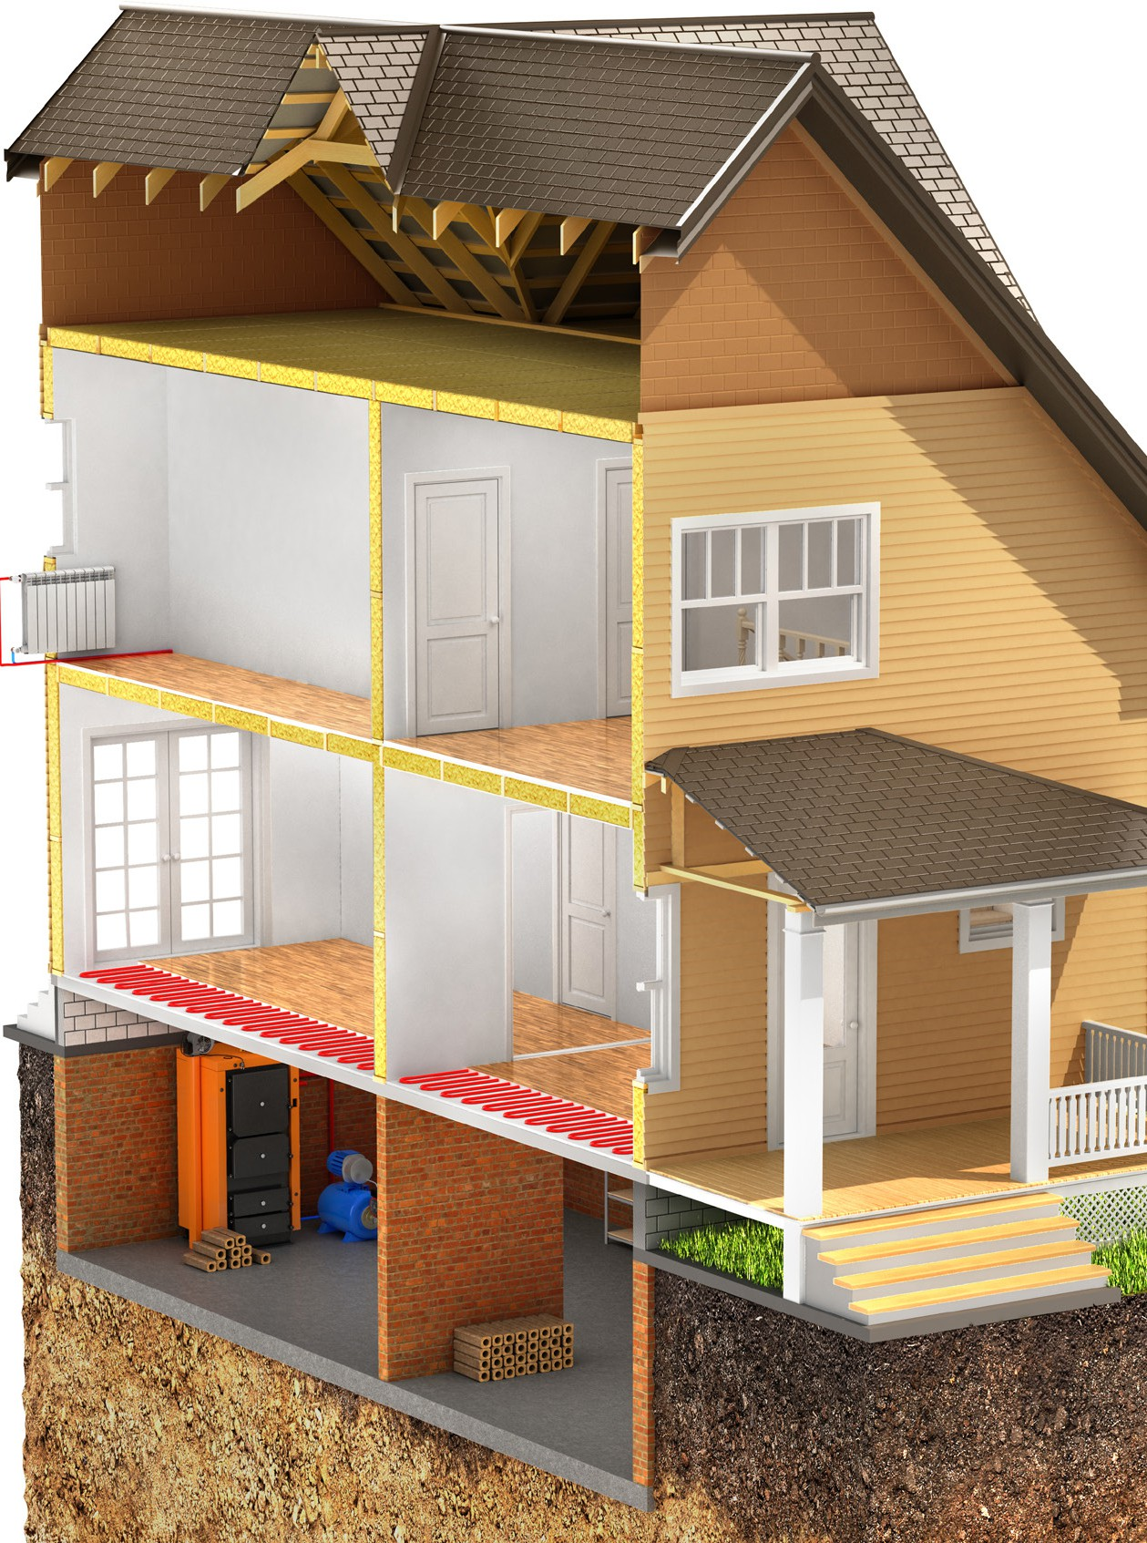
Stabilized material costs
offset by other factors
Material costs remained relatively stable in 2024 compared to prior years¹
+3.5% Asphalt roofing
However:
Houses are taking longer to build, and permit-to- completion time is now 15.2 months.¹
  Why? A stringent regulatory environment, supply- chain challenges, and the skilled labor shortage.
+1% Rough Framing/Lumber
0% Paint
+2.5% Drywall
An increase in adherence to building /energy codes and a growing demand for eco-friendly, sustainable building materials result in higher costs²
+2% Windows and doors
+4% Copper Electrical
+4% Copper Plumbing
+5% Concrete products
Source: 1. Materials Costs Per BLS (Bureau of Labor Statistics), YOY Averages from Jan 2024- October 2024,
2. Zhao, Na. “Single-Family Build Time Continues to Trend Upward” National Association of Home Builders, August 28, 2024,
3. “Costly Energy Codes and Rent Caps Will Harm Housing Affordability”, National Association of Home Builders, July 24, 2024
Notes:
You will recall us showing you substantial increase in material costs over the past couple of years.
On this slide, you can see that we’ve returned to more normal year over year increases.
However, it is taking longer to complete the new construction. In many places, the time it takes to secure permits is increasing, especially New York, Washington DC, Illinois, and many mountainous areas out west as well.
Add this time, to the cost of complying to building codes which often make up 25% of the price of a new construction and a shortage of qualified labor and you can see why the cost of construction continues to rise.

Slide 16
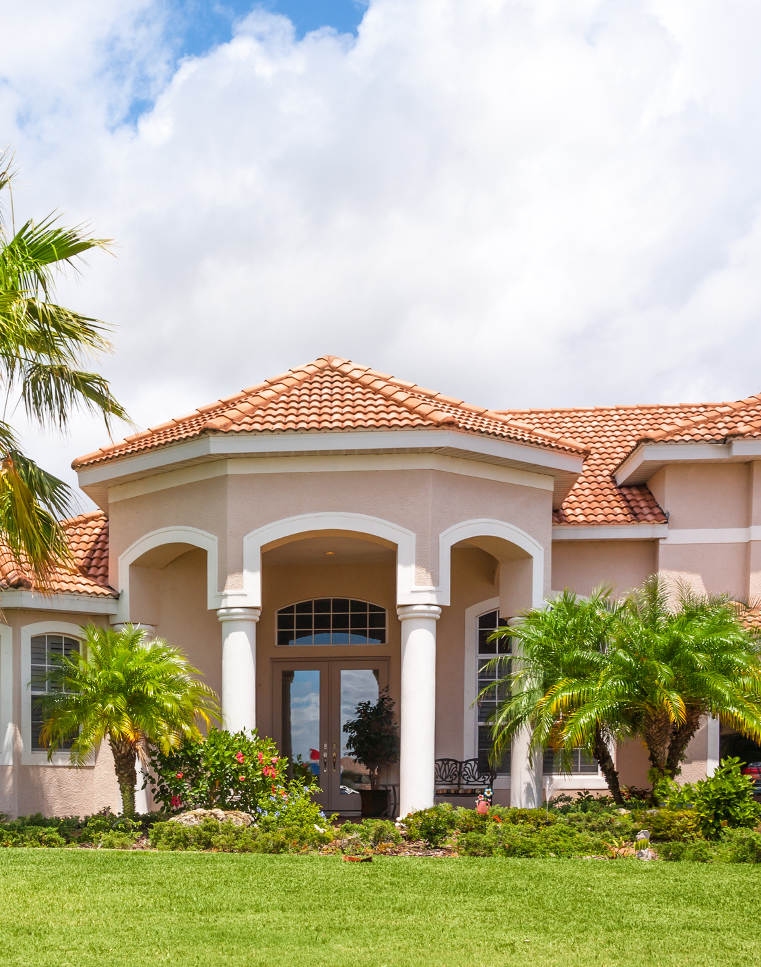
41 months to rebuild a home
Claims Example
Loss location: Watersound, FL
Claims payout: $2.5 million home
Total loss fire: August 2021
Total time to rebuild the home: 41 months
Permit was issued 08/26/22, and it took a little over a year to obtain the permit. Delays were exacerbated by both the HOA and the Walton County Building Dept.
Construction delays early on and skilled labor shortages. Builder insisted on using subs that he worked with in the past, and the demand for this skilled labor was higher than the supply.
The total claims costs were impacted by the increased additional living expense and both labor/material costs increased over the construction time period.
The claim scenarios described here are intended to show the types of situations that may result in claims. These scenarios should not be compared to any other claim. Whether or to what extent a particular loss is covered depends on the facts and circumstances of the loss, the terms and conditions of the policy as issued and applicable law. Facts may have been changed to protect privacy of the parties involved.
Source: Chubb PRS Claim data
Notes:
Here is an example of a standard fire loss to a home in Florida. It ended up taking 41 months to rebuild this home.
The permitting process took more than a year, add to that delays in supply chain as well as skilled labor shortages.
The claim became more expensive for us to settle with increased time needed for additional living expenses as well as the increase in labor and material costs over a longer period of time.

Slide 17




How CA wildfires will impact material costs
Looking at lumber as an example
  Roughly 10,000 homes may need to be rebuilt.
  That is double the number
  of new homes built annually in L.A. County.
  Lumber is the single biggest component of home-building materials, accounting for about 15% of overall home construction costs.
  Experts estimate that lumber prices could jump 25% to 40%.
Source: Don Lee, “Those rebuilding after L.A. fires will likely face higher lumber prices as Trump tariffs loom”, LA Times, January 16, 2025
Notes:
While the overall material costs have been stabilizing, it is important to consider the impact any major natural disaster has on supply and demand for new construction and renovations.
Using the CA wildfires as an example, lets look specifically at lumber costs.
There will be roughly 10,000 homes that need to be rebuilt in the footprint of the Palisades and Eaton fires.
Lumber is the biggest component of home building materials and experts are already estimating that lumber prices could jump anywhere from 25-40%. This doesn’t even contemplate the additional cost of lumber as a result of new tariffs. As an aside, we are obviously watching the tariff situation closely to determine what impact they will have on our overall cost of claims.

Slide 18
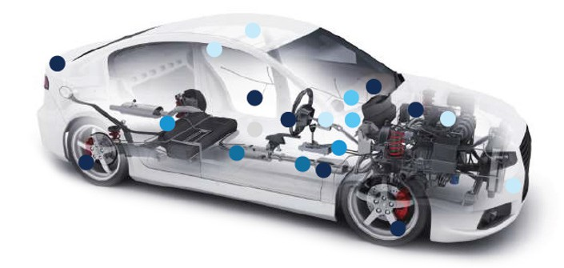













The continued complexities
of building new vehicles
5
5
1
1
3
1
1
5
3
1
5
6
4
2
6
1
2
1
5
1
Safety and convenience features improve the driving experience and reduce crash potential but also make vehicle construction more complex, and repairs more challenging and costly.
Electric vehicles have twice as many chips as internal combustion engine vehicles.
The average car is packed with 1,400 semiconductors that control everything from airbags to the engine. Modern cars simply cannot run without chips.
1
Safety
2
Comfort
4
Connectivity
Airbag controls
Collision- avoidance
Parking-assist
Power locks
Braking-assist
Tire pressure monitoring
Traction-control system
Window/mirror controls
Seat controls
Climate control
CAN (controller area network)
Broadband, Wi-Fi, Bluetooth
Over-the-air software updates
5
Electrical
3
Infotainment
Starter
Lighting system
Vehicle diagnostics
Audio/video
Driver display
Navigation
6
Powertrain
Engine control
Fuel injection system
Hybrid-electric control
Transmission control
P11
Source: CCC Intelligent Solutions Inc. Crash Course 2023
Notes:
Moving over to trends in auto. Safety and convenience features significantly enhance the driving experience and reduce crash risks.
However, these features contribute to more complex vehicle construction, making repairs more challenging and costly.
What you see on this slide are all the areas of a new vehicle that have become more complex over time. And when you consider the popularity of electric vehicles, they have twice as many chips compared to internal combustion engine vehicles.

Slide 19
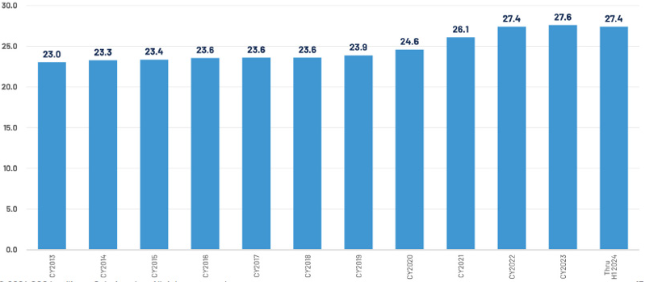
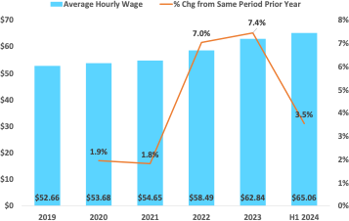
Labor wages and hours: higher per auto claim
A widening shortfall in the number of automotive technicians needed in the workforce means repairers have been raising wages and subsequent labor rates.
Combined with growing vehicle complexity, this has resulted in more labor hours per claim. The average number of labor hours per appraisal in 2023 increased slightly to 27.6 hours, following large jumps (2021
and 2022). H1 2024 appears stable at 27.4 hours
Labor rates are +3.5% however the first halves of 2024 and 2023, labor rates are +4.9% in 2024
Average number of labor hours per claim
CCC national industry average hourly labor rates
30.0
Average Hourly Wage
% Change from Same Period prior Year
26.1
27.4
27.6
27.4
$70
8%
25.0
23.0
23.3
23.4
23.6
23.6
23.6
23.9
24.6
$60
7%
20.0
$50
6%
15.0
$40
5%
10.0
$30
4%
$20
3%
5.0
2%
0.0
$10
1%
2013
2014
2015
2016
2017
2018
2019
2020
2021
2022
2023
Thru 1H 2024
$0
0%
2019
2020
2021
2022
2023
H1 2024
Source: CCC Intelligent Solutions Inc. Crash Course 2023
Notes:
Similar to residential contractors, there are not enough automotive technicians in the workforce which has a direct effect on driving higher wages and making the overall cost of labor climb.
In addition, the complexity of auto repairs has increased the number of hours it takes to get these cars back on the road. It now takes an average of 27.4 hours to repair a vehicle.

Slide 20
Liability — a continuing, top concern for affluent individuals
9/10
Wealth can create targets for
outsized personal injury lawsuits
Judgments have been dramatically
rising in dollar amounts*
This coverage gap between the perceived risk and the level of insurance coverage
for liability risk is a potentially dangerous one for successful individuals
of survey respondents are concerned about the potential size of a liability verdict against them
28%
of those surveyed carry
excess liability insurance
P20
Source: 2024 Chubb Wealth Report, *Risk & Insurance, Nuclear Verdicts Drive Rising US Liability Claims, 2024
Notes:
In our 2024 wealth report, we share that while 9/10 survey respondents are concerned about the potential size of a liability verdict against them, only 28% of those surveyed even carry excess liability insurance. This is a great opportunity for you as a broker or trusted advisor to work with these clients to ensure they have adequate protection against these unfortunate events.

Slide 21

Weather
Notes:
One of the most pressing trends impacting high net worth homeowners is the increase in severe weather events. From unprecedented storms and flooding to wildfires and rising sea levels, these environmental shifts are reshaping not only our climate but also the way affluent homeowners approach their properties.
Lets look at the weather that shaped 2024.

Slide 22
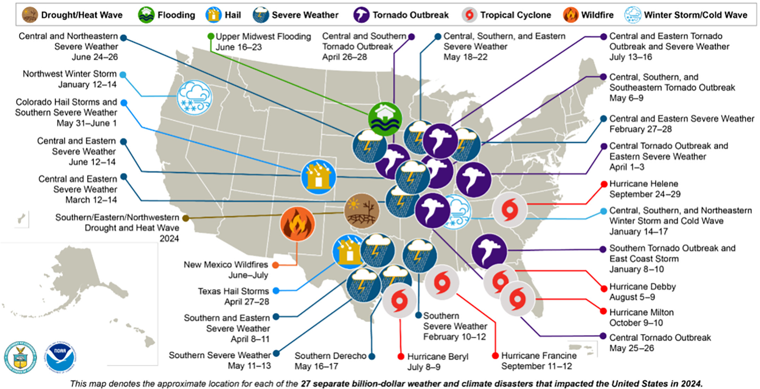
Another record-breaking year for billion-dollar disasters
U.S. 2024 billion-dollar weather and climate disasters
In 2024, there were 27 confirmed weather/ climate disaster events with losses exceeding $1B in the United States
These events included 17 severe storm events, 1 flooding event,
5 tropical cyclone events,
1 wildfire event,
2 winter storm events, and 1 drought event
P22
Source: NOAA National Centers for Environmental Information (NCEI) U.S. Billion-Dollar Weather and Climate Disasters (2024). https://www.ncei.noaa.gov/access/billions/, DOI: 10.25921/stkw-7w73
Notes:
This slide just gives you a visual as to the 27 Billion dollar CAT losses in 2024 and highlights where they occurred.
You may look at the graph and question why there is only one flooding event shown which was in the Midwest in June. It all depends on how the disaster was coded by the NOAA (National Oceanic and Atmospheric Administration). For example, Hurricane Helene was the designated disaster, but it produced the massive flooding in North Carolina.

Slide 23
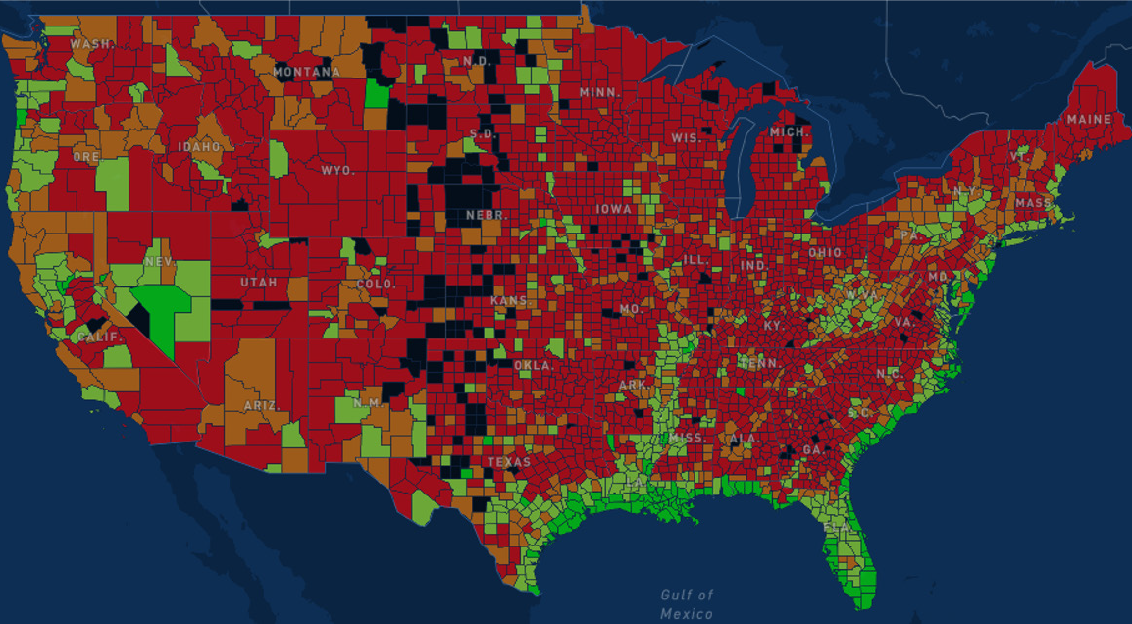
Flood risk continues to rise
Flooding is the most common and costly natural disaster in the United States, causing billions in economic losses each year. According to the National Flood Insurance Program (NFIP), 90% of all natural disasters in the United States involve flooding.
In 2024, at least 45 flood-related major disaster declarations according to FEMA
Percentage of homes with flood insurance (NFIP take-up rates)
% insured
<1.0%
<2.0%
<10.0%
>10.0%
P23
Source: https://resilience.iii.org/disasters/floods/#3.5/38.88/-98; https://disasterphilanthropy.org/disasters/2024-us-floods
Notes:
Another risk that continues to rise is flooding. Many places are no longer immune to flood losses, as we saw in the North Carolina mountains last year.
In 2024, FEMA declared at least 45 flood related major disasters and per the NFIP, 90% of all natural disasters in the US involve flooding .
This map shows the percentage of homes with flood insurance per the NFIP.
The red and orange areas show the geographies where less than 2% of the homes have flood coverage while the bright green areas are geographies where over 10% of the homes have flocoverage.
Our statistics for Chubb are similar, where only 4.4% of our customers in preferred flood zones currently purchase flood coverage from us.

Slide 24
Thank You

