Slide 1
AI’s Constantly Changing Landscape &
Insurance Applications
Lindsey Tonsanger, Co-Chair of Global Data Privacy and Cybersecurity Practice
Sabrina McGraw, Insurance Recovery and Policyholder Coverage Litigation Attorney

Slide 2
Disclaimer
The views and opinions expressed in this panel and in these slides are those of the speakers and do not necessarily reflect the views or positions of any organizations or entities they represent.

Slide 3
AI Regulation Is Exploding

Slide 4
Examples of Legal Frameworks
Bias and Discrimination
Safety
Consumer Rights and Transparency
CSAM
Deepfakes and Misinformation
Employment
Specific Technologies (e.g., LLMs, Generative AI, Foundation Models, Biometrics)
Regulated Industries (e.g., Education, Elections, Health, Housing, Insurance)
Vendor Management and Procurement

Slide 5
Example: CO AI Act
Fewer requirements for AI Systems
A machine-based system that infers from inputs how to generate outputs that can influence physical or virtual environments
High-Risk AI is heavily regulated
An AI System that makes or is a substantial factor in making a decision that has a material legal or similarly significant effect on the provision or denial to a consumer, or the cost or terms of: education, employment, financial or lending service, essential government service, healthcare, housing, insurance, or legal services.

Slide 6
Draft CCPA Regulations: Key Thresholds for ADMT
Any technology that processes personal information and uses computation to execute a decision, replace human decisionmaking, or substantially facilitate human decisionmaking
Significant Decision
Financial or lending services, housing, insurance, education enrollment or opportunity, criminal justice, employment or independent contracting, healthcare services, or essential goods or services
Extensive Profiling
Analyzing interests, behavior, location, or personality traits
In the workplace or at school
In public places
To target first- or third-party ads
Training ADMT
Capable Of:
Significant decisions
Establishing identity
Physical or biological ID or profiling
Deepfakes

Slide 7
Privacy Trends
Individual Rights
Choice
Data Protection Impact Assessments
Pre-Use Notice & Transparency

Slide 8
Section 5 of the FTC Act
Deception
Likely to mislead consumers
Unfairness
Likely to cause substantial consumer injury
Considered from the perspective of a reasonable consumer
Material — i.e., likely to affect consumer’s choice or conduct regarding a product
Not reasonably avoidable by consumers
Not outweighed by countervailing benefits to consumers or competition

Slide 9
Regulatory Trends for Section 5
Content Moderation Enforcement
Personalization and Minors
Biometrics
Fake Consumer Reviews
Bias and Unfairness
Use of Data for Model Training

Slide 10
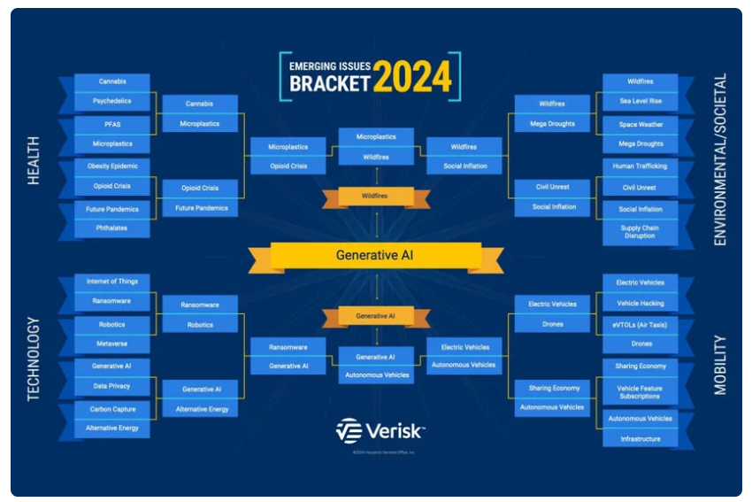
Insurers are Paying Attention to AI
Verisk/Insurance Services Office’s views AI as a key “Emerging Issue”
  Inputs: concerned with copyright infringement and privacy concerns with training data
  Outputs: concerned with reliance on erroneous information produced by AI
  Use: cyber criminals or amplification of misinformation or civil unrest

Slide 11
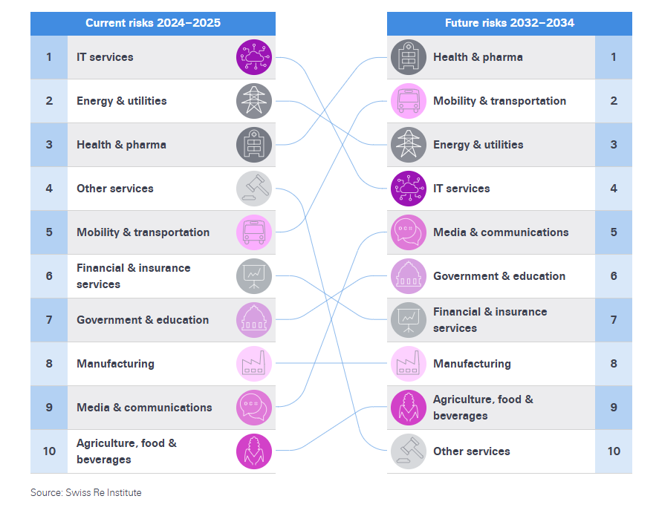
Insurers are Paying Attention to AI
Swiss Re Institute Research: Risks currently in IT but likely to shift to other industries

Slide 12

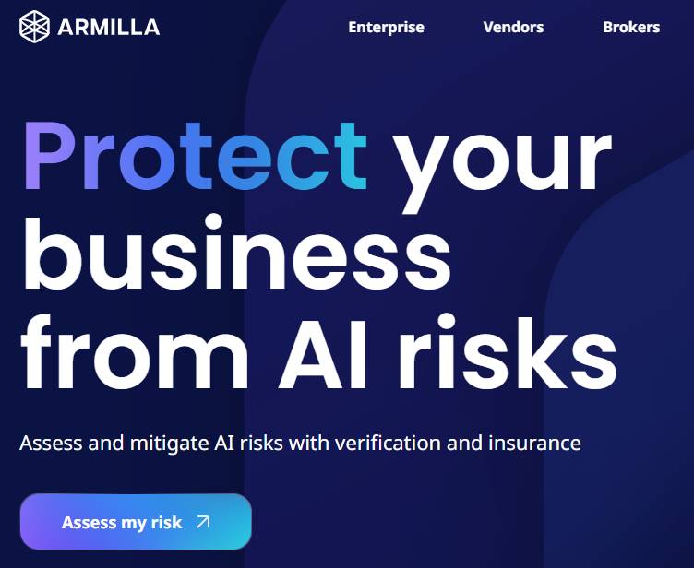
AI-Specific Insurance
Munich Re’s aiSure
  Insurance for AI products to work as advertised
Armilla Assurance is offering a new policy for “AI Vendors”

Slide 13
Coverage for Artificial Intelligence/Machine Learning
General Liability
Cyber
Errors & Omissions
Directors & Officers
Property/ Business Interruption

Slide 14
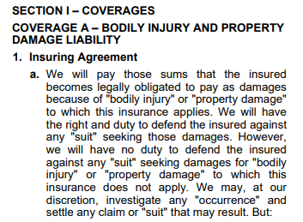
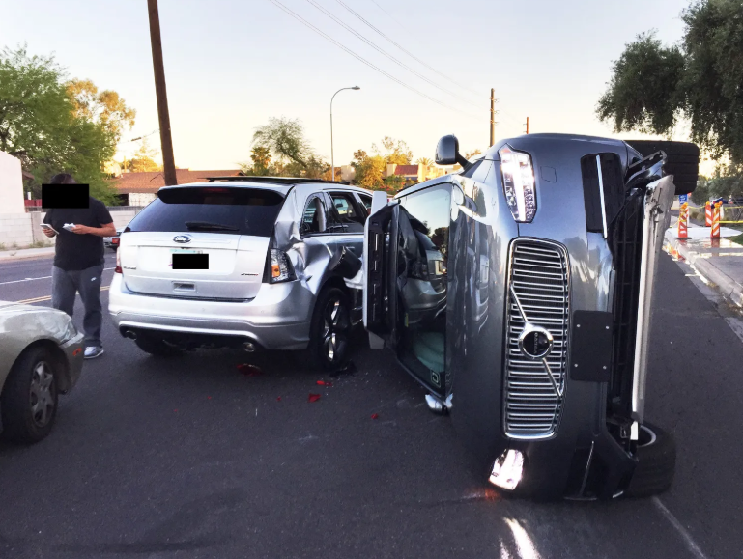
General Liability
Source: ISO CGL Form

Slide 15
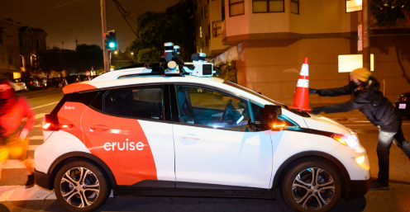

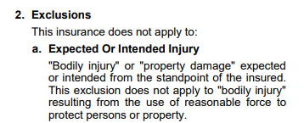

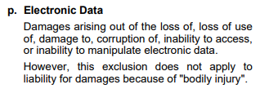
General Liability
Source: ISO CGL Form

Slide 16

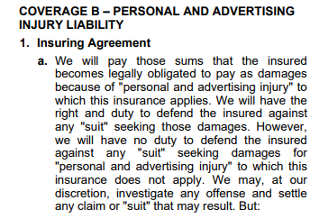
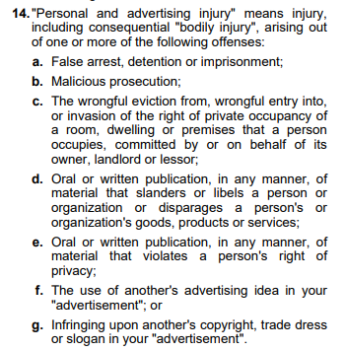
General Liability
Source: ISO CGL Form

Slide 17
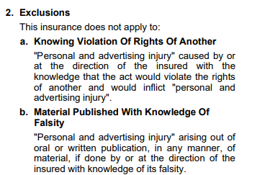
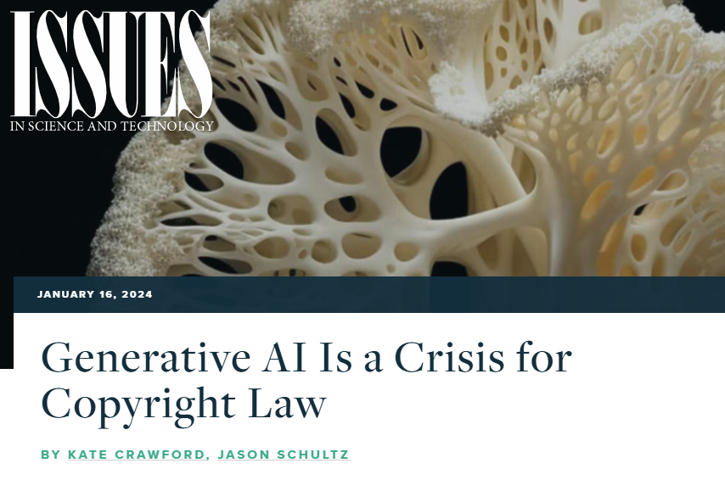
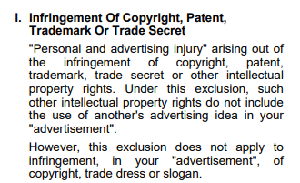
General Liability
Source: ISO CGL Form

Slide 18

Cyber
Typically covers:
  Security breaches liability
  Extortion threats
  Restoration of electronic data and business interruption losses

Slide 19
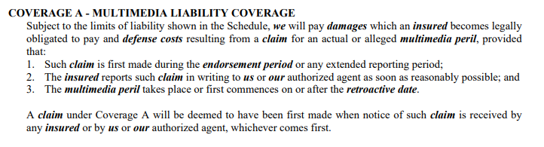

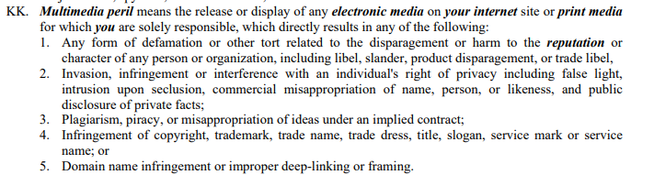
Cyber
Source: URB Cyber Form

Slide 20

Errors & Omissions
Technology E&O Policies tend to cover tech-related businesses
Usually covers:
Breach of warranty
Breach of contract
Negligence
Misrepresentation
Copyright infringement
Privacy breaches and failure to comply with privacy regulations/unfair or deceptive trade practices

Slide 21
Errors & Omissions
Media Liability Coverage
We shall pay on your behalf all sums, not exceeding the limits of insurance and in excess of the applicable deductible set forth in the Declarations, for which you shall become legally obligated to pay as damages resulting from any claim first made against you during the policy period or any subsequent extended reporting period arising out of a media wrongful incident in connection with scheduled media and committed after the retroactive date stated in ITEM 4 in the Declarations and prior to the end of the policy period provided that:
This policy does not apply to any claim or claim expenses:
A. Arising out of, resulting from, based upon or in consequence of, directly or indirectly, any actual or alleged copyright infringement arising from software or computer hardware.”
Source: Philadelphia Media Liability Endorsement Form

Slide 22
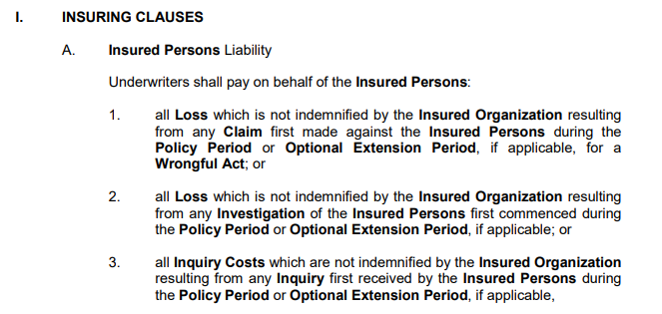
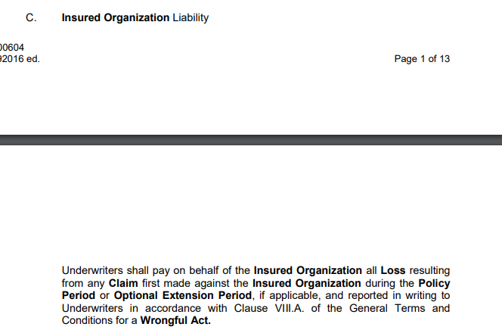
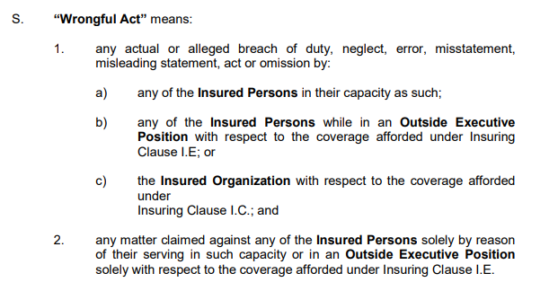
Directors & Officers
Source: Beazley D&O Form

Slide 23


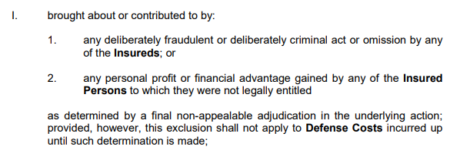
Directors & Officers
Source: Beazley D&O Form

Slide 24
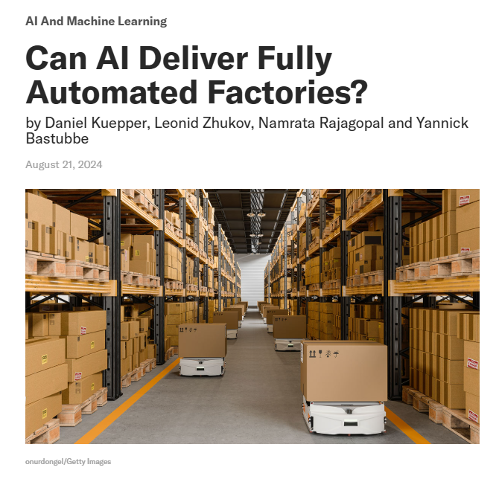
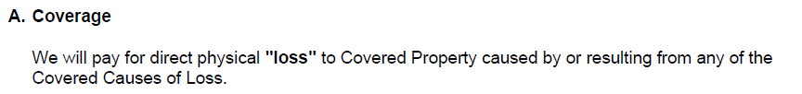
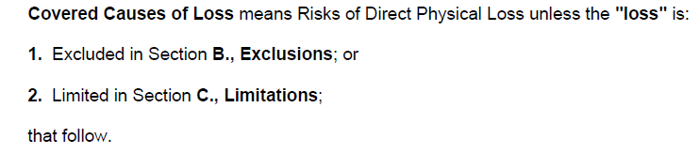
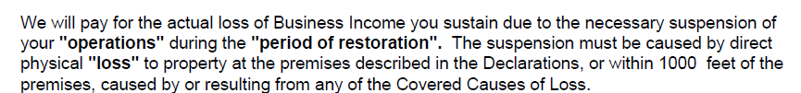
Property/ Business Interruption

Slide 25
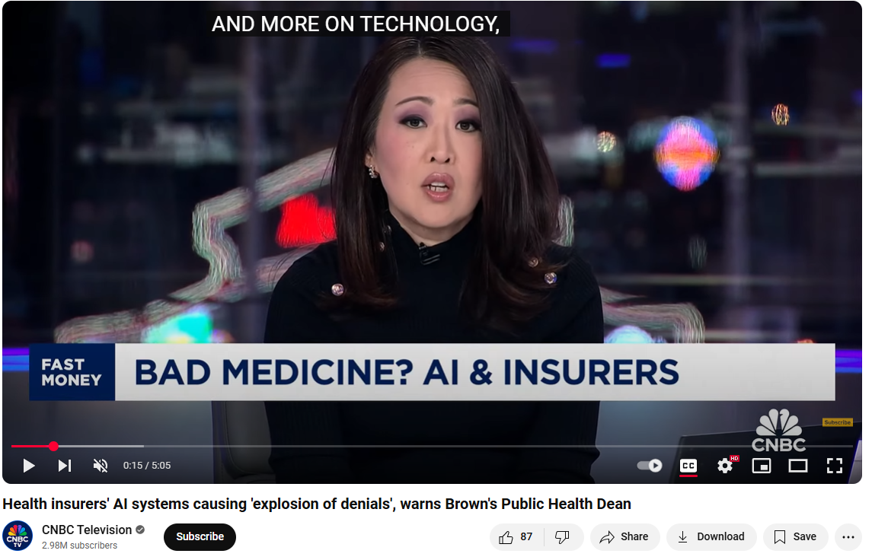
AI and Bad Faith
Insurers are using AI for claims too.

Slide 26
Q&A
Notes:
Replace with handout summary of questions

Slide 27


Contact Info
Lindsey Tonsager
ltonsager@cov.com
415-591-7061
Sabrina McGraw
smcgraw@cov.com
415-591-7082

